Slide 1
Java Programming, 9e Chapter 5
Making Decisions

Slide 2
Objectives (1 of 2)
Plan decision-making logic
Make decisions with the if and if…else statements
Use multiple statements in if and if…else clauses
Nest if and if…else statements
Use AND and OR operators

Slide 3
Objectives (2 of 2)
Make accurate and efficient decisions
Use the switch statement
Use the conditional and NOT operators
Assess operator precedence
Add decisions and constructors to instance methods

Slide 4
Planning Decision-Making Logic (1 of 5)
Pseudocode
Use paper and a pencil
Plan a program’s logic by writing plain English statements
Accomplish important steps in a given task
Use everyday language
Flowchart
Steps in diagram form
A series of shapes connected by arrows

Slide 5
Planning Decision-Making Logic (2 of 5)
Flowchart (cont’d.)
Programmers use a variety of shapes for different tasks
Rectangle to represent any unconditional step
Diamond to represent any decision
Sequence structure
One step follows another unconditionally
Cannot branch away or skip a step

Slide 6
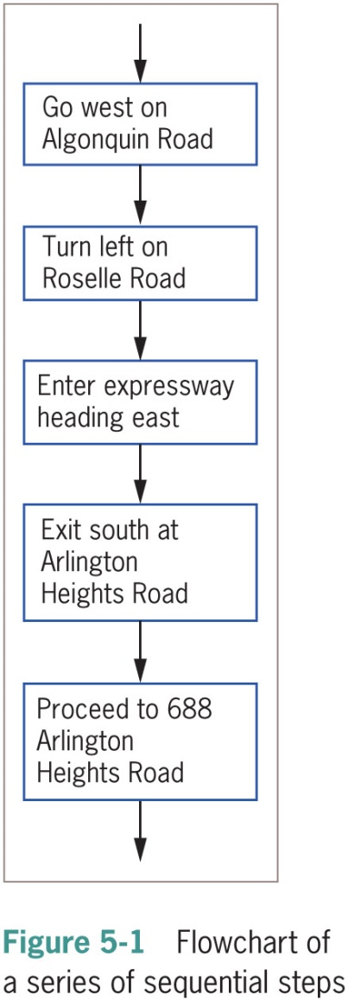
Planning Decision-Making Logic (3 of 5)

Slide 7
Planning Decision-Making Logic (4 of 5)
Decision structure
Involves choosing among alternative courses of action
Based on some value within a program
All computer decisions are yes-or-no decisions
Boolean values
true and false values
Used in every computer decision

Slide 8
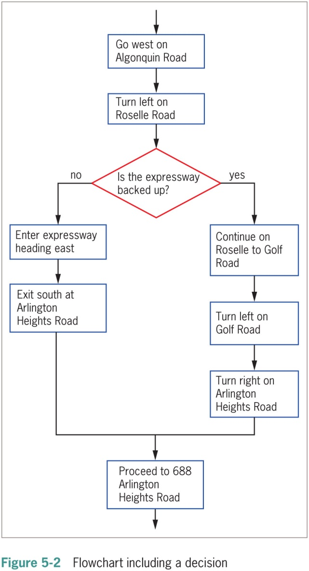
Planning Decision-Making Logic (5 of 5)

Slide 9
The if and if…else Statements (1 of 2)
if statement
The simplest statement to make a decision
A Boolean expression appears within parentheses
No space between the keyword if and the opening parenthesis
Execution always continues to the next independent statement
Use a double equal sign ( == ) to determine equivalency

Slide 10
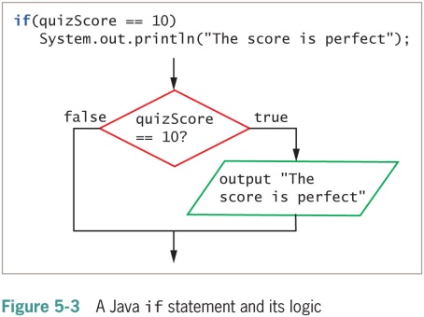
The if and if…else Statements (2 of 2)

Slide 11
Pitfall: Misplacing a Semicolon in an if Statement (1 of 2)
There should be no semicolon at the end of the first line of the if statement
if(someVariable == 10)
The statement does not end there
When a semicolon follows if directly:
An empty statement contains only a semicolon
Execution continues with the next independent statement

Slide 12
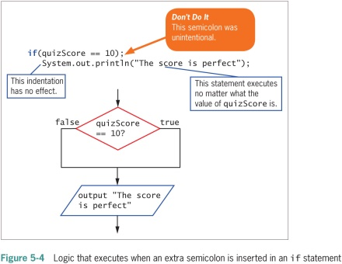
Pitfall: Misplacing a Semicolon in an if Statement (2 of 2)

Slide 13
Pitfall: Using the Assignment Operator Instead of the Equivalency Operator
Attempt to determine equivalency
Using a single equal sign rather than a double equal sign is illegal
You can store a Boolean expression’s value in a Boolean variable before using it in an if statement

Slide 14
Pitfall: Attempting to Compare Objects Using the Relational Operators
Use standard relational operators to compare values of primitive data types
Not objects
You can use the equals and not equals comparisons ( == and != ) with objects
Compare objects’ memory addresses instead of values

Slide 15
The if…else Statement (1 of 3)
Single-alternative if
Perform an action, or not
Based on one alternative
Dual-alternative if
Two possible courses of action
if…else statement
Performs one action when a Boolean expression evaluates as true
Performs a different action when a Boolean expression evaluates as false

Slide 16
The if…else Statement (2 of 3)
if…else statement (cont’d.)
A statement that executes when if is true or false and ends with a semicolon
Vertically align the keyword if with the keyword else
Illegal to code else without if
Depending on the evaluation of the Boolean expression following if, only one resulting action takes place

Slide 17
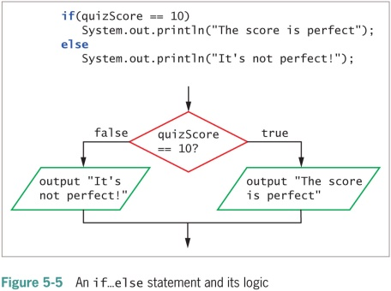
The if…else Statement (3 of 3)

Slide 18
Using Multiple Statements in if and if…else Clauses (1 of 2)
To execute more than one statement, use a pair of curly braces
Place dependent statements within a block
Crucial to place the curly braces correctly
Any variable declared within a block is local to that block

Slide 19
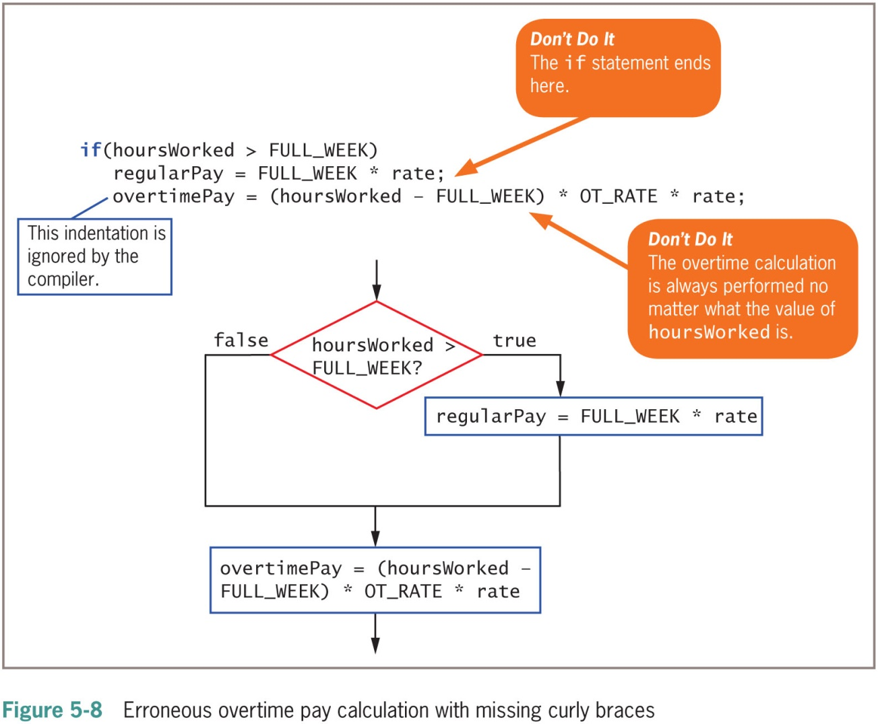
Using Multiple Statements in if and if…else Clauses (2 of 2)

Slide 20
Nesting if and if…else Statements (1 of 2)
Nested if statements
Statements in which an if structure is contained inside another if structure
Two conditions must be met before some action is taken
Pay careful attention to the placement of else clauses
else statements are always associated with if on a “first in-last out” basis

Slide 21
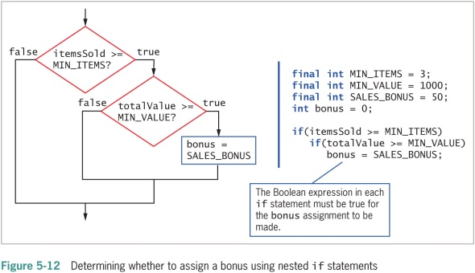
Nesting if and if…else Statements (2 of 2)

Slide 22
Using Logical AND and OR Operators (1 of 5)
The logical AND operator
An alternative to some nested if statements
Used between two Boolean expressions to determine whether both are true
Written as two ampersands ( && )
Include a complete Boolean expression on each side
Both Boolean expressions that surround the operator must be true before the action in the statement can occur

Slide 23
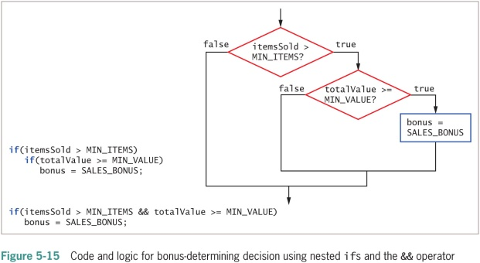
Using Logical AND and OR Operators (2 of 5)

Slide 24
Using Logical AND and OR Operators (3 of 5)
The OR operator
An action to occur when at least one of two conditions is true
Written as ||
Sometimes called pipes

Slide 25
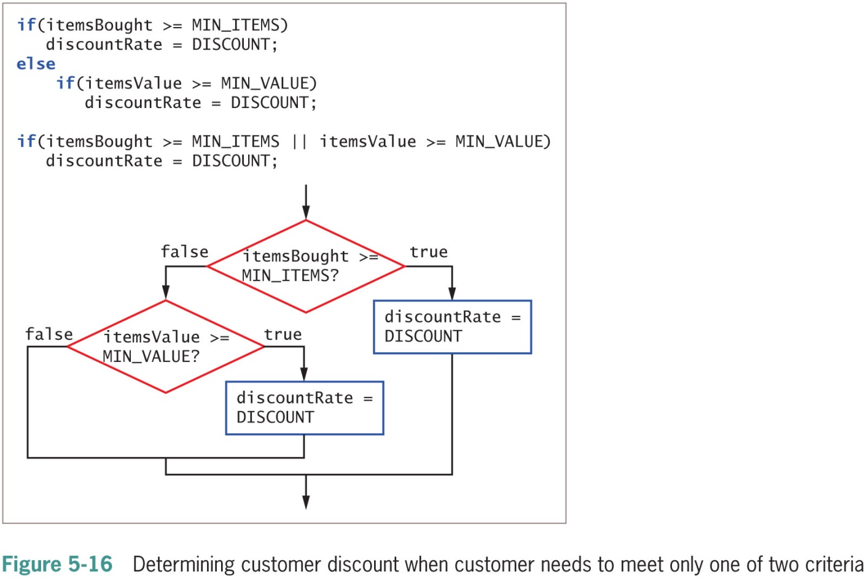
Using Logical AND and OR Operators (4 of 5)

Slide 26
Using Logical AND and OR Operators (5 of 5)
Short-circuit evaluation
Expressions on each side of the logical operator are evaluated only as far as necessary
Determine whether an expression is true or false

Slide 27
Making Accurate and Efficient Decisions (1 of 4)
Making accurate range checks
Range check: a series of if statements that determine whether a value falls within a specified range
Java programmers commonly place each else of a subsequent if on the same line
Within a nested if…else statement:
It is most efficient to ask the most likely question first
Avoid asking multiple questions

Slide 28
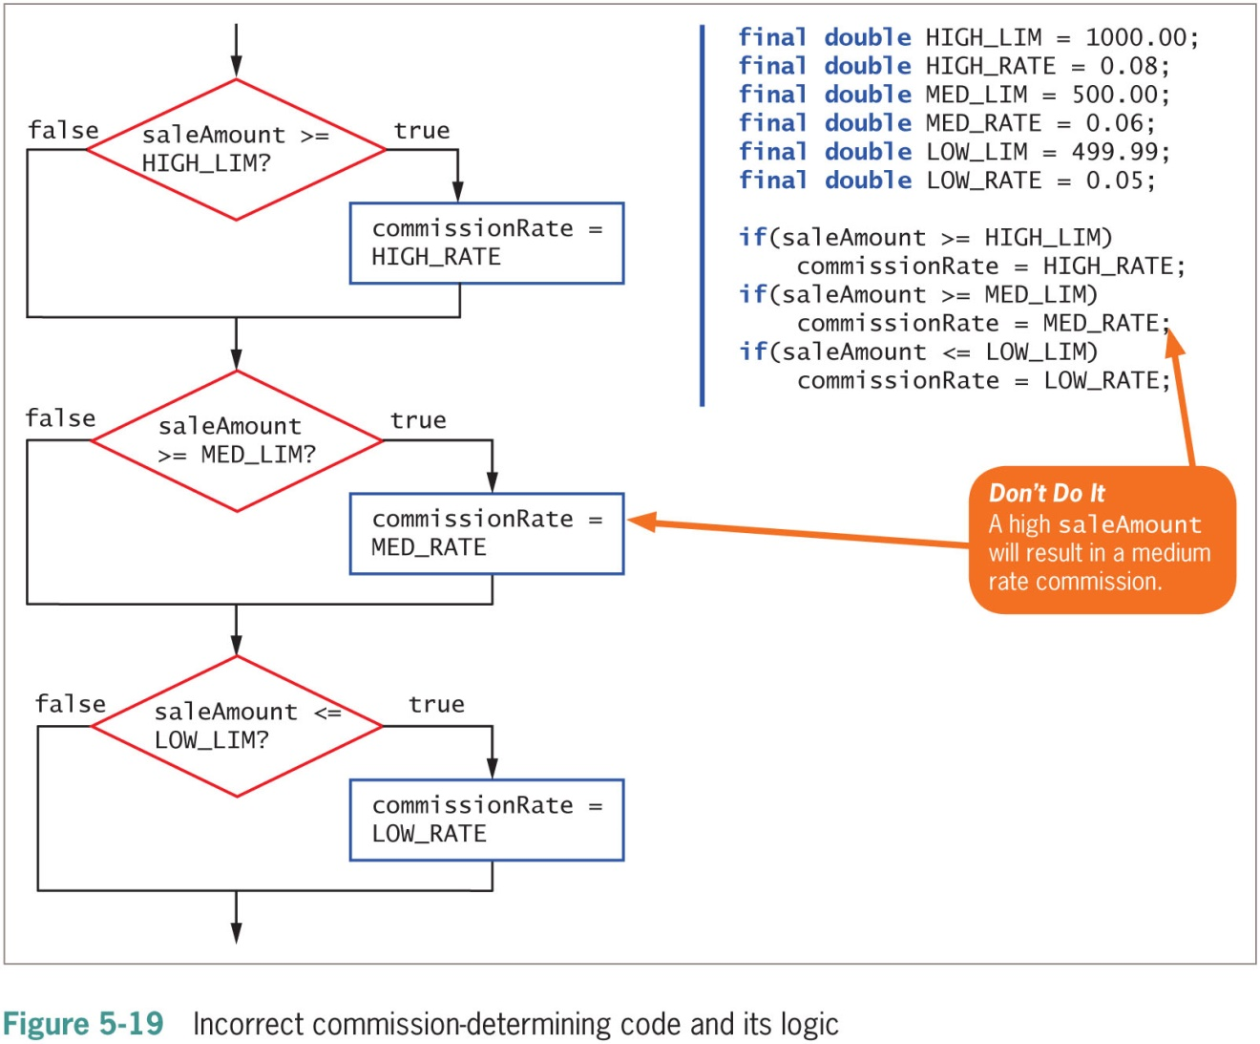
Making Accurate and Efficient Decisions (2 of 4)

Slide 29
Making Accurate and Efficient Decisions (3 of 4)
It is most efficient to ask a question most likely to be true first
Avoids asking multiple questions
Makes a sequence of decisions more efficient

Slide 30
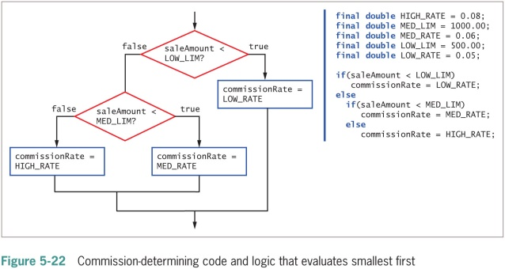
Making Accurate and Efficient Decisions (4 of 4)

Slide 31
Using && and || Appropriately
Errors of beginning programmers:
Using the AND operator when they mean to use OR
Example: No payRate value can ever be both less than 5.65 and more than 60 at the same time
if(payRate < LOW && payRate > HIGH)
System.out.println("Error in pay rate");
Use pipes “||” operator instead
Using a single ampersand or pipe to indicate a logical AND or OR

Slide 32
Using the switch Statement (1 of 3)
switch statement
An alternative to a series of nested if statements
Test a single variable against a series of exact integer, character, or string values
Keywords
switch
Starts the structure
Followed by a test expression enclosed in parentheses
case
Followed by one of the possible values for the test expression and a colon
break
Optionally terminates a switch statement at the end of each case
default
Optionally is used prior to any action that should occur if the test variable does not match any case

Slide 33
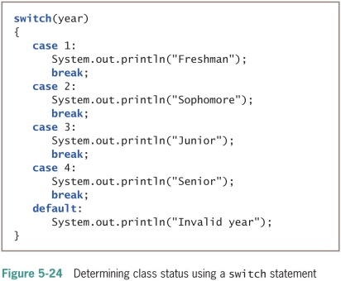
Using the switch Statement (2 of 3)

Slide 34
Using the switch Statement (3 of 3)
break statements in the switch structure
If a break statement is omitted:
The program finds a match for the test variable
All statements within the switch statement execute from that point forward
case statement
No need to write code for each case
Evaluate char variables
Ignore whether it is uppercase or lowercase
Why use switch statements?
They are convenient when several alternative courses of action depend on a single integer, character, or string value
Use only when there is a reasonable number of specific matching values to be tested

Slide 35
Using the Conditional and NOT Operators (1 of 2)
Conditional operator
Requires three expressions separated with a question mark and a colon
Used as an abbreviated version of the if…else structure
You are never required to use it
Syntax of a conditional operator:
testExpression ? trueResult : falseResult;

Slide 36
Using the Conditional and NOT Operators (2 of 2)
A Boolean expression is evaluated as true or false
If the value of testExpression is true:
The entire conditional expression takes on the value of the expression following the question mark
If the value is false:
The entire expression takes on the value of falseResult
An advantage of using the conditional operator is the conciseness of the statement

Slide 37
Using the NOT Operator
NOT operator
Written as an exclamation point ( ! )
Negates the result of any Boolean expression
When preceded by the NOT operator, any expression evaluated as:
true becomes false
false becomes true
Statements with the NOT operator:
Are harder to read
Require a double set of parentheses

Slide 38
Understanding Operator Precedence (1 of 4)
Combine as many AND or OR operators as needed
An operator’s precedence
How an expression is evaluated
The order agrees with common algebraic usage
Arithmetic is done first
Assignment is done last
The AND operator is evaluated before the OR operator
Statements in parentheses are evaluated first

Slide 39
Understanding Operator Precedence (2 of 4)
Table 5-1 Operator precedence for operators used so far
Precedence | Operator(s) | Symbol(s)
Highest | Logical NOT | !
Intermediate | Multiplication, division, modulus Addition, subtraction Relational Equality Logical AND Logical OR Conditional | */% + – > < >= <= == != && || ?:
Lowest | Assignment | =

Slide 40
Understanding Operator Precedence (3 of 4)
Two important conventions
The order in which operators are used makes a difference
Always use parentheses to change precedence or make your intentions clearer

Slide 41
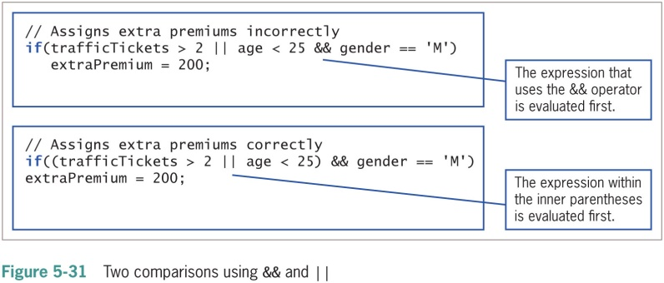
Understanding Operator Precedence (4 of 4)

Slide 42
Adding Decisions and Constructors to Instance Methods (1 of 2)
Helps ensure that fields have acceptable values
Determines whether values are within the allowed limits for the fields

Slide 43
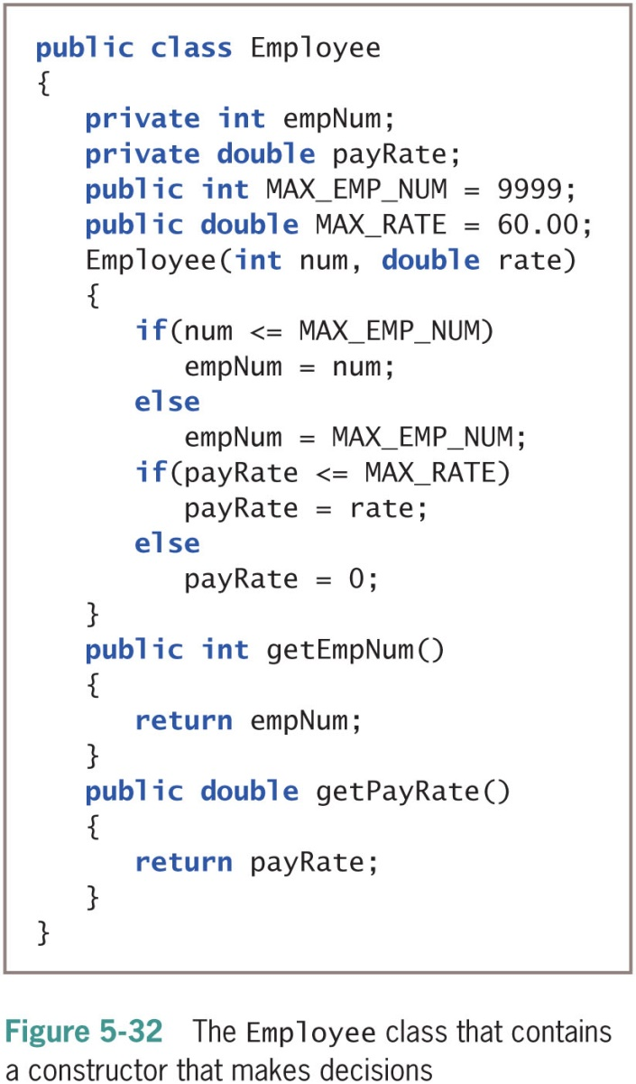
Adding Decisions and Constructors to Instance Methods (2 of 2)

Slide 44
Don’t Do It (1 of 2)
Don’t ignore subtleties in boundaries used in decision making
Don’t use the assignment operator instead of the comparison operator
Don’t insert a semicolon after the Boolean expression in an if statement
Don’t forget to block a set of statements with curly braces when several statements depend on the if or the else statement

Slide 45
Don’t Do It (2 of 2)
Don’t forget to include a complete Boolean expression on each side of an && or || operator
Don’t try to use a switch structure to test anything other than an integer, a character, or a string value
Don’t forget a break statement if one is required
Don’t use the standard relational operators to compare objects

Slide 46
Summary (1 of 3)
if statement
Makes a decision based on a Boolean expression
Single-alternative if
Performs an action based on one alternative
Dual-alternative if
if…else
Performs one action when a Boolean expression evaluates as true
Performs a different action when an expression evaluates as false

Slide 47
Summary (2 of 3)
AND operator
&&
Determines whether two expressions are both true
OR operator
||
Carries out some action even if only one of two conditions is true
switch statement
Tests a single variable against a series of exact integer or character values

Slide 48
Summary (3 of 3)
Conditional operator
An abbreviated version of an if…else statement
NOT operator
!
Negates the result of any Boolean expression
Operator precedence

